Slide 1
AbhayKshirsagar-Team
Team :
Anurit Dey
Abhay Kshirsagar
Shivam Kumar

Slide 2
Dataset Details

Slide 3
Exploratory Data Analysis and Data Cleaning
For training our Neural Network Model we used only the weather data given to us and not the satellite images.
In test data we noticed since the radiance values are always greater than 0. We decided to choose a subset of 480 min time frame when the albedo and Cloud cover values are significant.
We choose the the time frame from 8:00 in the morning till 16:00 or 4:00 PM in the evening. We took only this range of training data as the albedo and cloud cover during this period is significant.
Now we removed any negative cloud cover values by taking the average between the two consecutive data points.
For the parameters we considered the columns based on correlation data and some physical intuition which lead to cloud formation.

Slide 4
EDA and Regularization
We used the following list of columns for training. We used snip and wind speed.

Slide 5
Robust Scaler
For regularizing the data we used the Robust Scaler function from sklearn library.
Robust Scaler can remove all the outliers from the dataset
The implementation of the method discussed above is given in the following slide.
Before fitting this function we first split the dataset such that first 300 days go in the train and the rest 66 in test data.
Here the cloud cover is the target column so we apply a separate but same transformation.

Slide 6
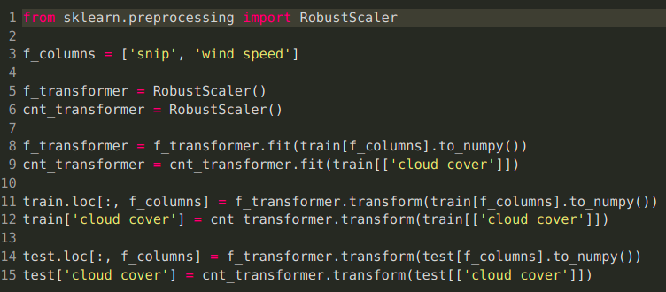

Slide 7
Creating Training Dataset
Since this data is time series and discontinuous between each day we iteratively considered data from each day from a dictionary of unique day values (of the format dd/mm). The function is given in the following slide.
In each data given a time split the time frame given by the variable time_split of the train is fed into X_train and the immediate y value to the y_train.

Slide 8
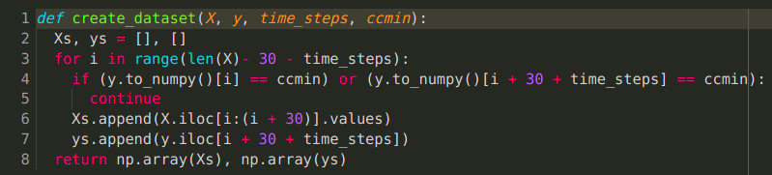
Function for Creating Dataset

Slide 9
Existing / PreExisting Work

Slide 10
Resources
As such we didn’t use any direct papers or publications however we used a few tutorial videos and articles explaining how LSTMs worked and their applications.
Some resources we used:
https://www.youtube.com/watch?v=tepxdcepTbY
https://towardsdatascience.com/lstm-networks-a-detailed-explanation-8fae6aefc7f9

Slide 11
Experimental Results

Slide 12
Model Details
For Solving time series models we researched many models like RNN, GRU, LSTMS and CNN. From these we decided to go with LSTMs as it has been well researched and great for time series modelling. We used the open source Keras Library by Tensorflow for implementing our model.
Our model consists of a Bidirectional LSTM followed by Dropout layer and a Dense layer of 1 neuron. We have provided the hyper parameters used below and the model architecture in the next slide. The model we used was inspired by Sreeni the youtube video in Resources. We didn’t use any transfer learning. We changed the dataset and tried different hyperparameters for the model.

Slide 13
Hyperparameters
Optimizer = Adam (lr = 0.002, betas = [0.9, 0.999])
Training parameters = 12, Testing parameters = 1 (cloud cover)
Time_steps = [120, 90, 60, 30]
Batch Size = 360
Loss = Mean Squared Error
Validation Split = 0.1
Dropout = 0.2
LSTM units = 16

Slide 14
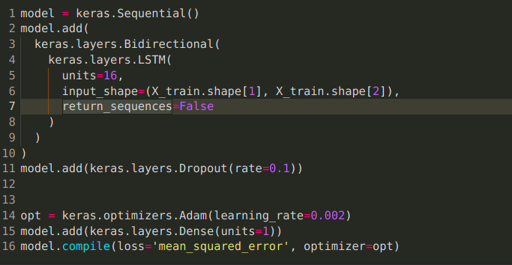
LSTM Architecture

Slide 15
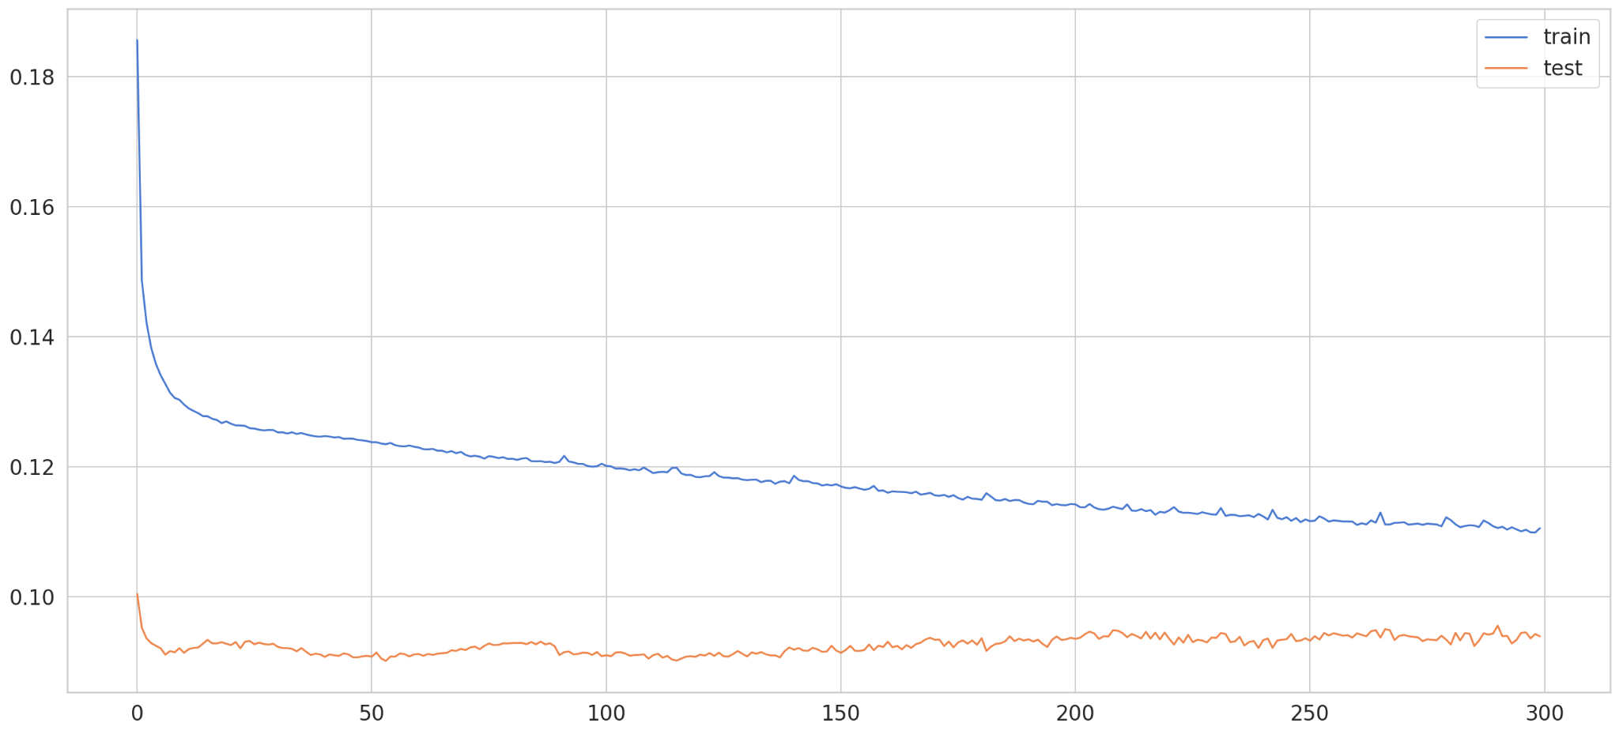
Results : Training and Validation Loss
For this case our model trained for 300 epochs and 30 time_steps from which we extrapolated the other values

Slide 16
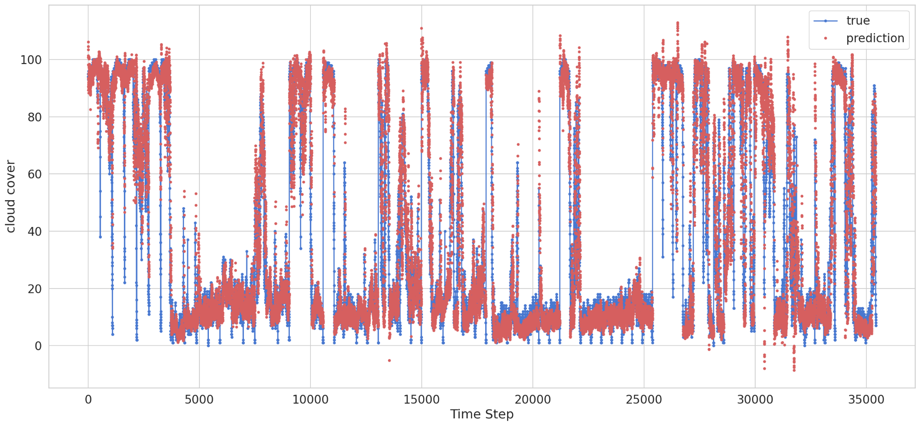
Comparing Validation and Training Set

Slide 17
Creating Submission File
The regularization processes discussed for creating train dataset is reused again.
Here we directly use the create_dataset_test() function and predict the 30 min, 60 min, 90 min and 120 min horizon.
The following slide has the code.

Slide 18
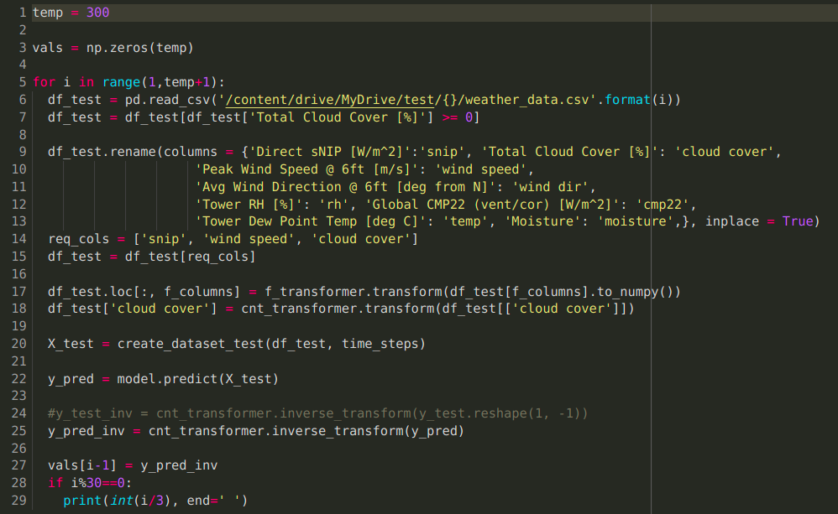
Submission File code

Slide 19
Conclusion
The stated model in this presentation is very accurate and achieved a score of 89.46
For the Level 2 we will be incorporating the image dataset provided using much more sophisticated neural network and physical models which might be able to increase the accuracy even further.
However the model provided does accomplish the goal by accurately predicting the cloud cover efficiently. Given more time we can even modify the model learn learn in real time and make decisions accordingly.

Slide 20
Hardware and Software specifications

Slide 21
Hardware Specifications
We used colab notebook with GPU accelerations provided by the free tier colab’s Nvidia Tesla K80 GPU
We did not use our own GPU
Software packages
Keras == 2.7.0
Tensorflow == 2.7.0
Performance Numbers
The max time that was spent for the final score was 37 mins.
License
The solution is Open Sourced
The License used is MIT License

